Slide 1
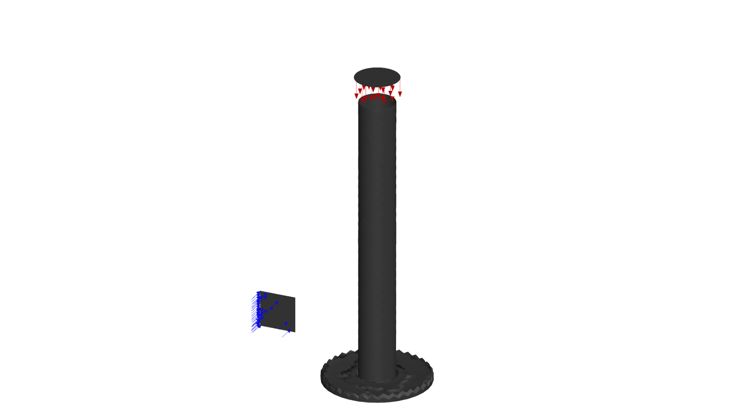
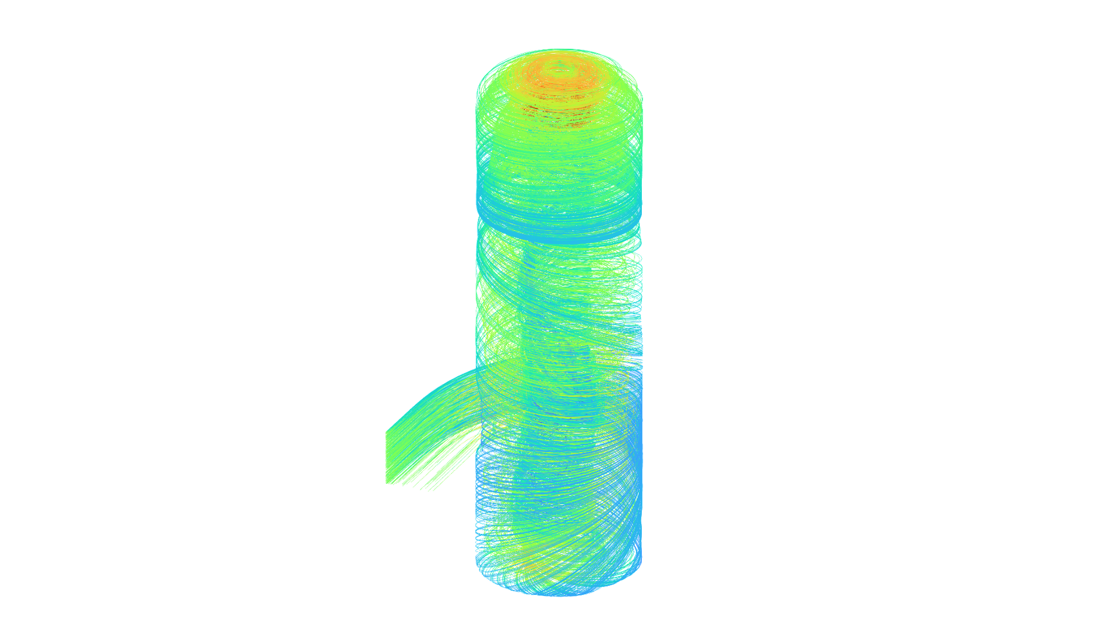
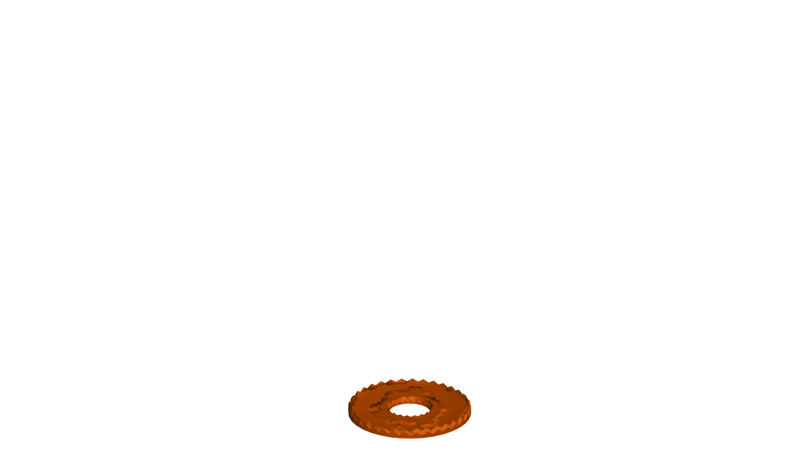
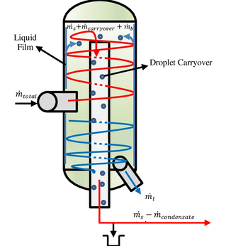
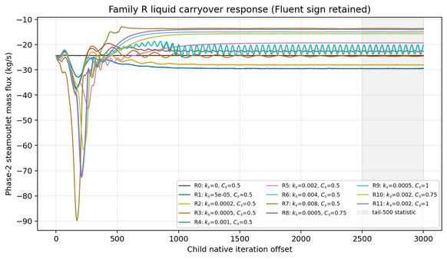
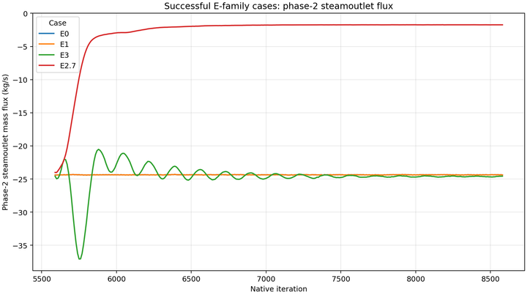
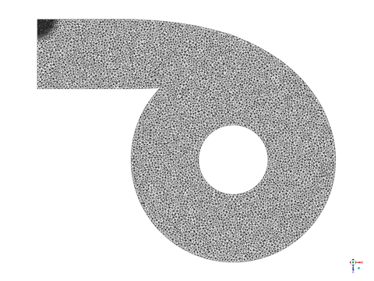
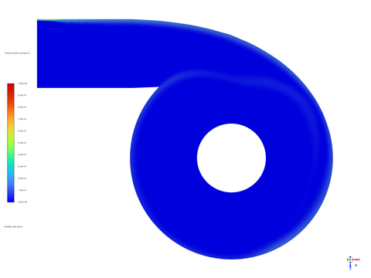
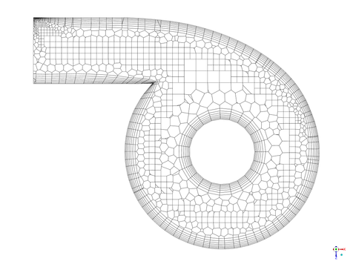


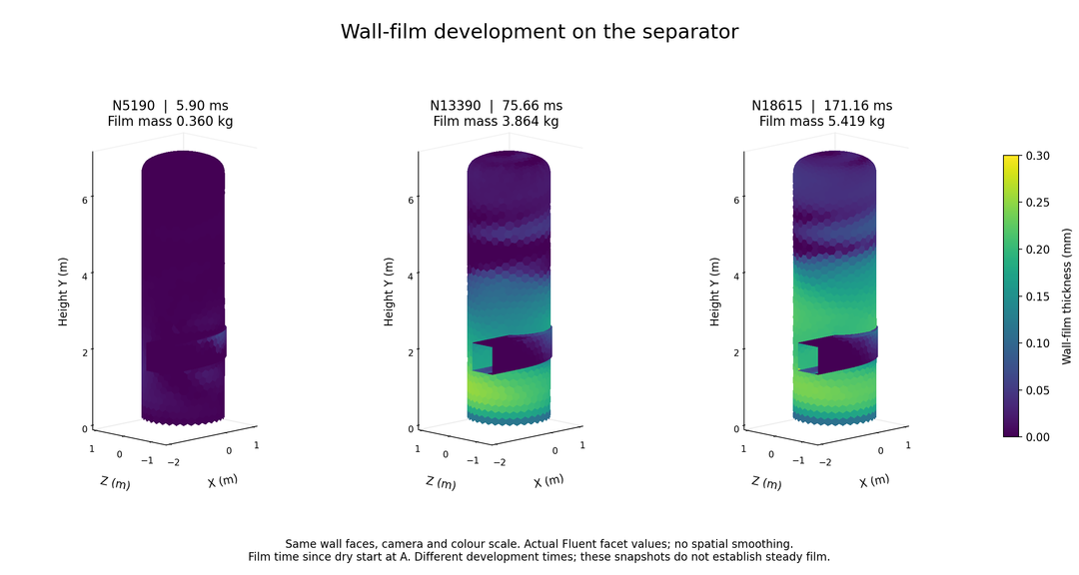
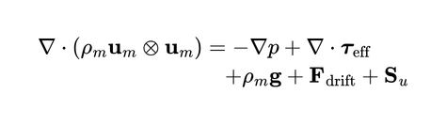
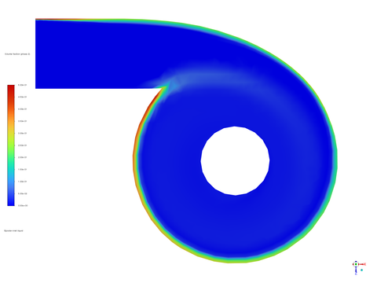


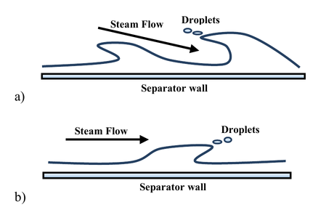
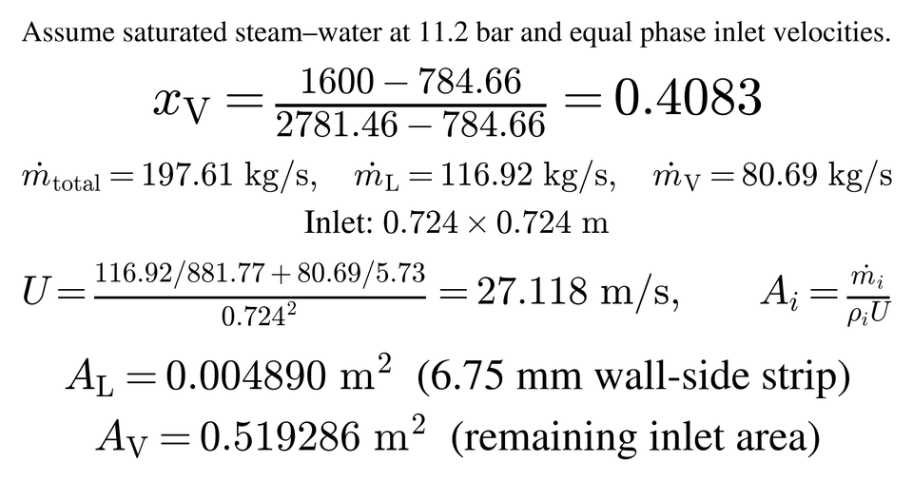
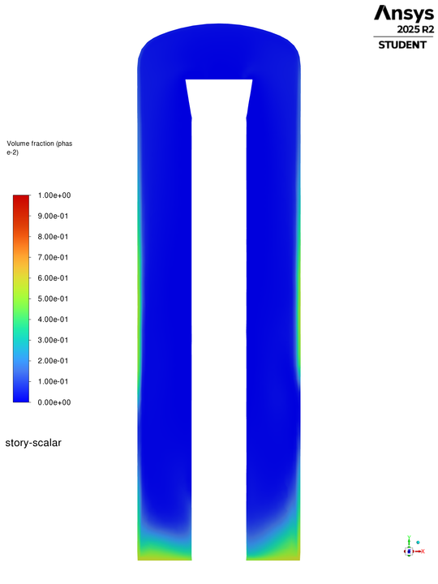
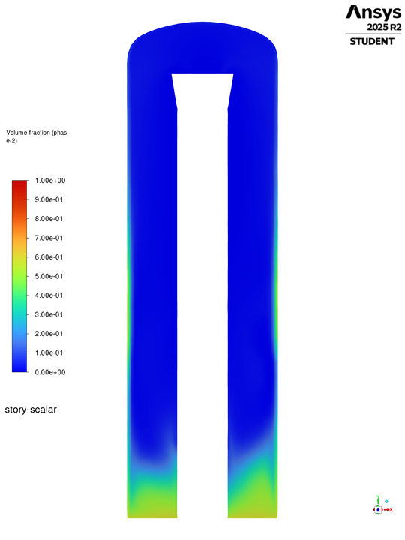
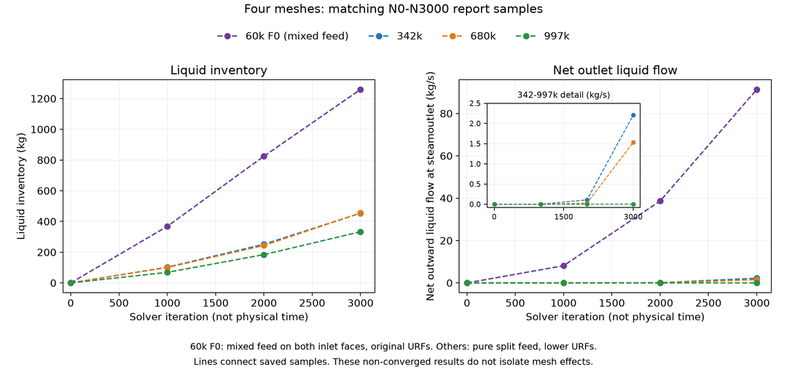

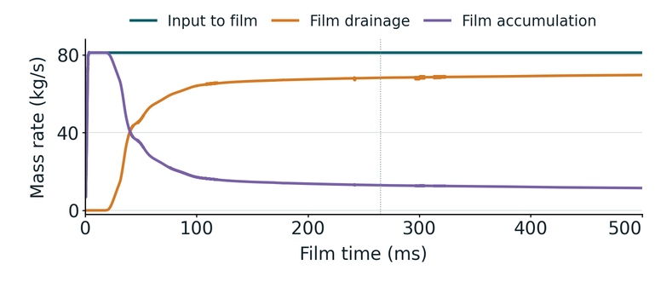



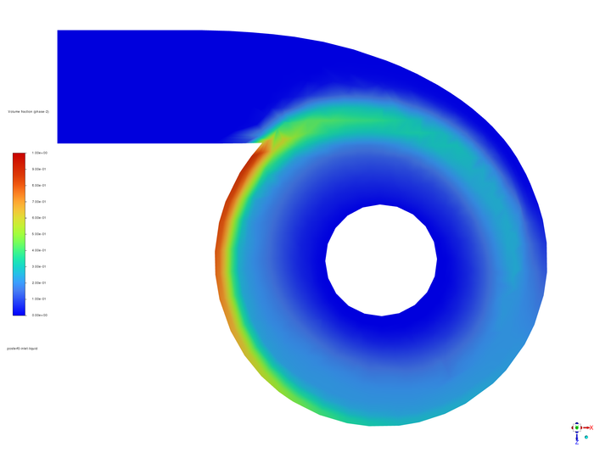
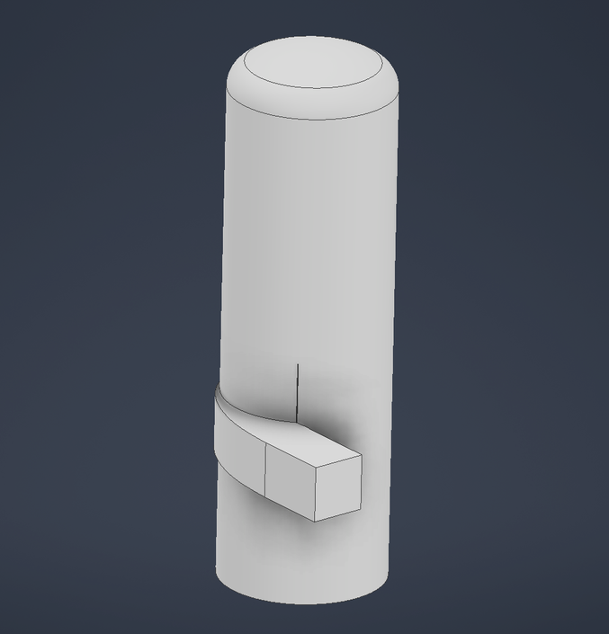
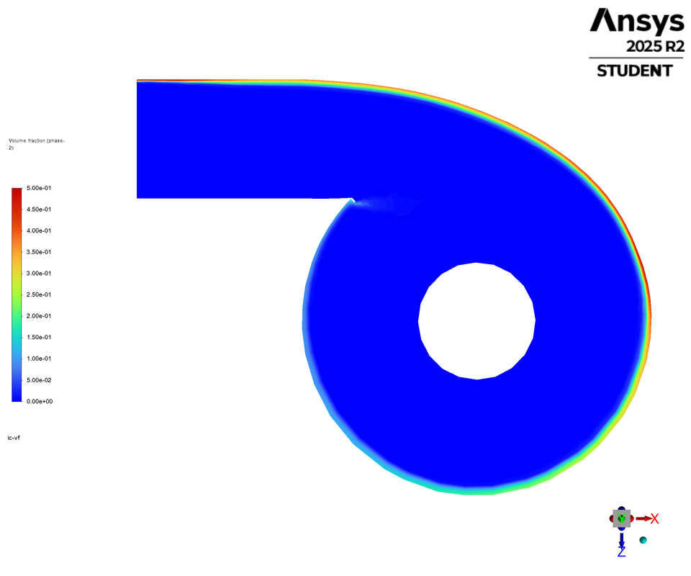
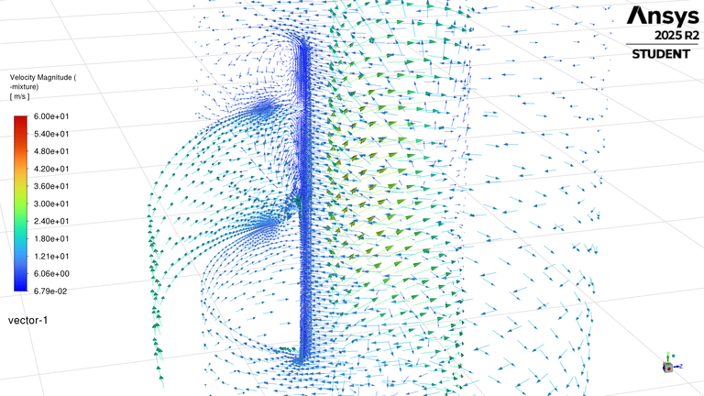





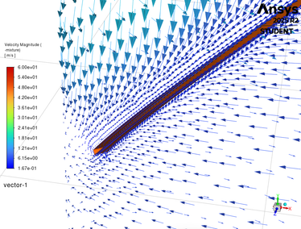
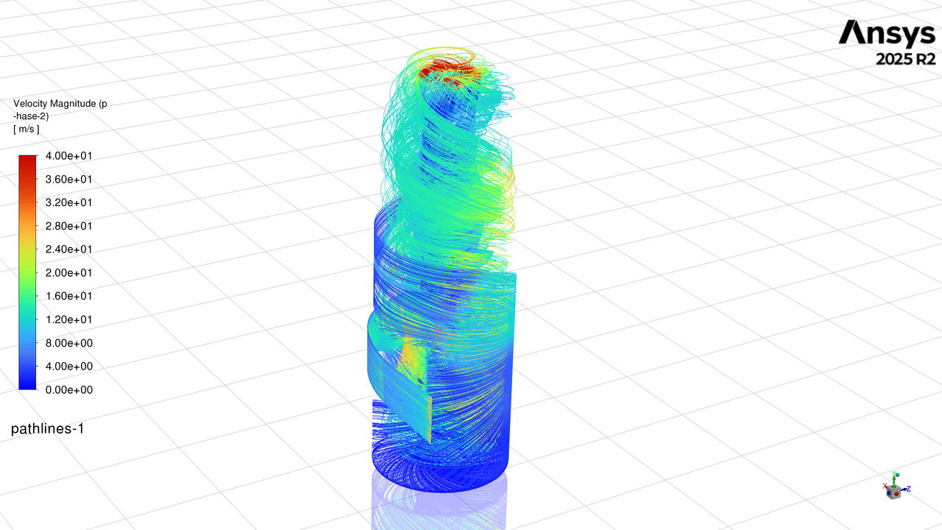
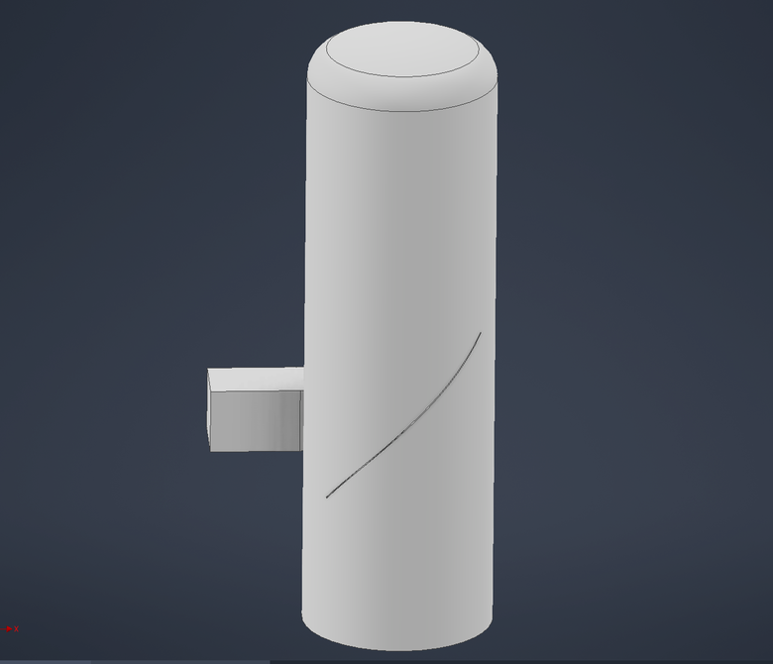

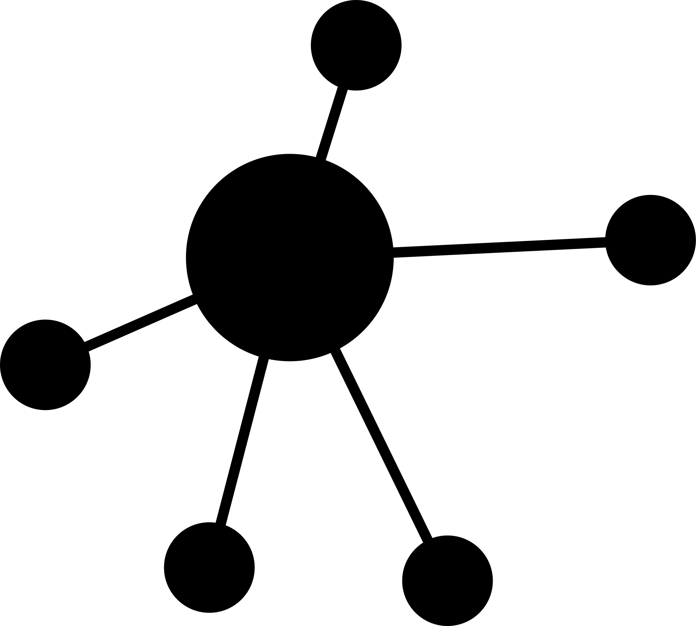

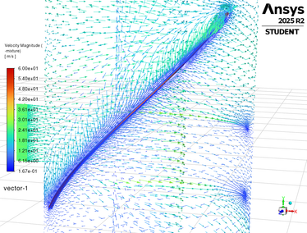




Project #60: Geothermal steam-water separator
design CFD modelling and optimising
Andy Tran & Shuhei Yokkaichi
Supervisor(s): Assoc. Prof. Sadiq Zarrouk, Dr Maedeh Amirpour
Background
Fluent Solver Settings:
Bulk Solver:
  Pressure-based, steady, absolute velocity formulation
Pressure–velocity coupling:
  Coupled
Multiphase Model:
  Mixture, Steam-liquid phases
Turbulance:
  RNG k-e, differential viscosity, swirl correction ON, compressibility correction ON
  RE ≈ 7.4 × 106
Near Wall Treatment:
  Standard wall functions
Wall Roughness:
  Commercial Steel (0,045mm)
Wall Liquid Interaction
Geothermal separators supply dry, clean steam to turbines. Liquid carryover can cause erosion and mineral deposits [1]..
Cyclone flow moves mineral-bearing water (brine) towards the wall, where it forms a draining film. Droplets can still leave with the steam.
Building on Purnanto et al. [2], this study develops a computational fluid dynamics (CFD) model to examine liquid collection, wall roughness and wall-film behaviour.
Why the wall matters: Swirl drives liquid towards the wall, where it can collect as a film and drain downwards. Wall friction, film formation and drainage are central to understanding separator behaviour.
Strong response to settings:
  Roughness changed outlet liquid non-monotonically (−44.09% at 8 mm).
  With film accretion, bulk outlet liquid fell 24.37 → 1.74 kg/s (−92.88%)
Wall treatment strongly affected the model response. Lower outlet flow accompanied inventory loss.
Mesh
Poly-hexcore meshing was selected to improve cell quality and support faster model development. An efficient hexahedral core reduces computational cost, polyhedral cells support gradient estimation and transitions between cell types, and wall layers provide targeted refinement near the separator surface.
Wall Film Behaviour
Mass conservation
Film spreads and stores liquid:
Early runs showed a broader, thicker film over the lower and middle walls. The upper wall remained thinner.
Two Phase Inlet
Momentum conservation
A liquid strip is placed beside the wall, as liquid can flow along the upstream pipe wall, and the swirl pushes it towards the separator wall. This lets us study wall-film formation and drainage. The strip is an assumed inlet profile.
At 11.2 bar, the mass fraction is:
Using the reference feed rate of 197.61 kg/s and enthalpy of 1600 kJ/kg.
Liquid-phase transport
Liquid Absorber
Added models to represent re-entrainment:
Later runs added stripping, splashing and edge separation to represent liquid re-entrainment from the wall film into the steam flow. These processes allow collected liquid to return as droplets, so wall contact does not guarantee permanent separation.
Problem: Simplified model does not provide a path for liquid to be removed, and liquid inventory kept increasing.
Assumption: Full mass and momentum transfer to a one-way brine pool.
  Remove liquid only.
  Remove its mass and momentum together.
  Ramp feed and removal together.
EWF Mechanism:
  Phase Accretion ON
Film Velocity Calculation:
  Full Momentum equation
Film Momentum Terms:
  Gravity, gas shear, wall-viscous resistance, and momentum advection ON
Surface Tension: 0.04041N/m
Film pressure and spreading ON
DPM collection and splashing ON
Particle Separation and Stripping ON
1.33 × 10−2
Minimum continuity value
2.27 × 10−3
Absorber off
Absorber on
Methodology: Experiment Workflow
Design Proposals to Increase Separation Efficiency
Fluent Agent Harness
Problem to address
Three design concepts are proposed to improve liquid collection:
  Vertical film blocker: intercept circulating wall liquid before it meets the incoming steam.
  Angled film ramp: redirect wall liquid towards the lower collection region.
A more radical proposal (Not shown on the left)
  External collection channel: collect wall liquid through a shell opening and route it down an external drain.
Their effect on separation performance remains unverified. With short film development times and differences in mesh and film-model settings, the volume fraction and velocity vector figures show preliminary inlet-region behaviour; they do not isolate geometry effects or demonstrate improved efficiency.
Future work: Assess steam-outlet liquid carryover, collected liquid, film accumulation and pressure drop.
Execution Loop
GitHub
Propose a hypothesis through collaborative discussion
CONTEXT.md
+ setup.md(s)
This keeps the agent from deviating from task with durable human direction
Write python code to modify settings to build new case through PyFluent
PyFluent Guide to build an accurate TUI command to enable the correct setting
Wall liquid re-entering bulk flow at the inlet.
Design Proposal
Volume Fraction
If Auto Loop mode enabled
Delegate to multiple computers
Knowldege Base
One Drive file sharing
Connect to Fluent
Stores reusable knowledge from research papers, CFD theory and Fluent guidance, with links to the supporting sources and most importantly previous experiments.
Result.md
Use analysis SKILL to create relavant plots, contours, and tables to report the results.
Allocate an agent per session and run simulation
Create the new case, and verify the new case
References
[1] Zarrouk, S. J. & Purnanto, M. H. (2015). Geothermal steam-water separators: Design overview. Geothermics, 53, 236–254. doi:10.1016/j.geothermics.2014.05.009.
[2] Purnanto, M. H., Zarrouk, S. J. & Cater, J. E. (2013). CFD modelling of two-phase flow inside geothermal steam-water separators. IPENZ Transactions, 40.

